Slide 1
Security Database
By Antonio Torres-Ruiz and Christopher Hester

Slide 2
How did we build the system?
Our system was built in two parts:
Database, titled Security
User interface
The Database has 6 tables, each filled with its columns containing corresponding data
Alarm
Camera
Equipment
Guard
Location
Incident
The interface was coded in Python
Allows the user to connect to the database, create a table in the database, add date to a table of the user’s choice, run queries to return crucial/important information for security companies, and disconnect from the database when operations are done.

Slide 3
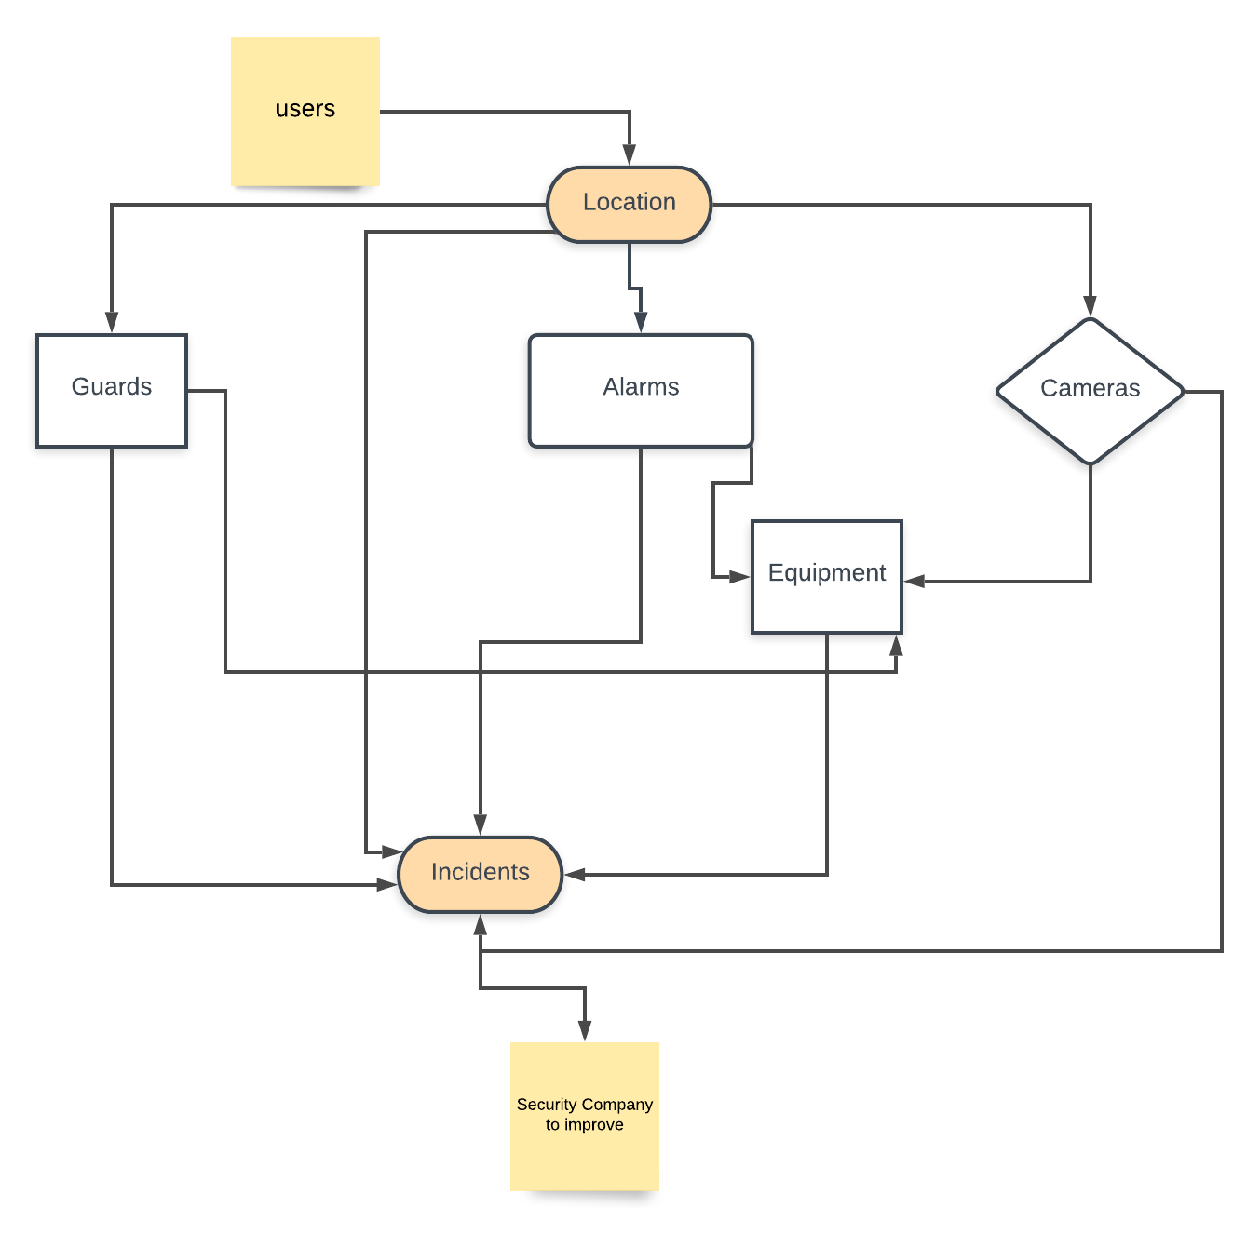
UML Diagram

Slide 4
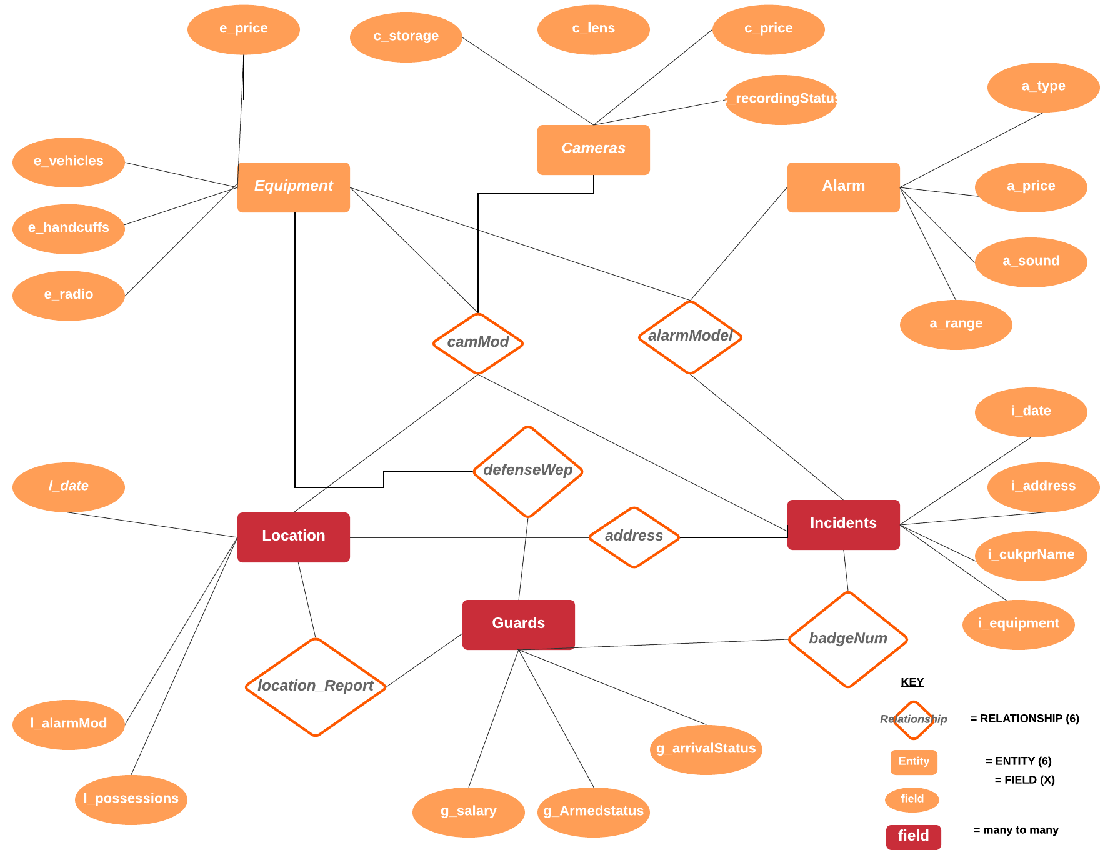
E/R Diagram

Slide 5
Relational Schema
• Location(l_date, l_camMod, l_address, l_badgeNum, l_alarmMod, l_possessions)
• Alarms(a_model, a_type, a_price, a_sound, a_range)
• Guards(g_salary, g_armedStatus, g_arrivalStatus, g_defenseWep, g_badgeNum)
• Equipment(e_price, e_alarmMod, e_camMod, e_vehicles, e_handcuffs, e_radio, e_defenseWep)
• Cameras(c_model, c_storage, c_lens, c_price, c_recordingStatus)
• Incidents(i_alarmMod, i_camMod, i_date, i_culpritName, i_equipment, i_address, i_badgeNum)

Slide 6
What did we build?
We used a database called Security, with 6 tables having one to seven columns for appropriate data.
The data felt appropriate to implement into the database as this data could be useful for security companies looking to improve security systems put on homes (such as checking for incidents that happen at locations, the cameras and alarms there, equipment used, guards on the scene, etc.)
The user interface was coded using Python and followed a very similar structure to Lab 7 and the in-class demonstration for connecting to a database using Python.
Following these examples, we mimicked and then expanded upon them to make a user interface that provided more options for the user.

Slide 7
Demo
Any questions?

